Slide 1
HTML5 and CSS3
SEO

Slide 2
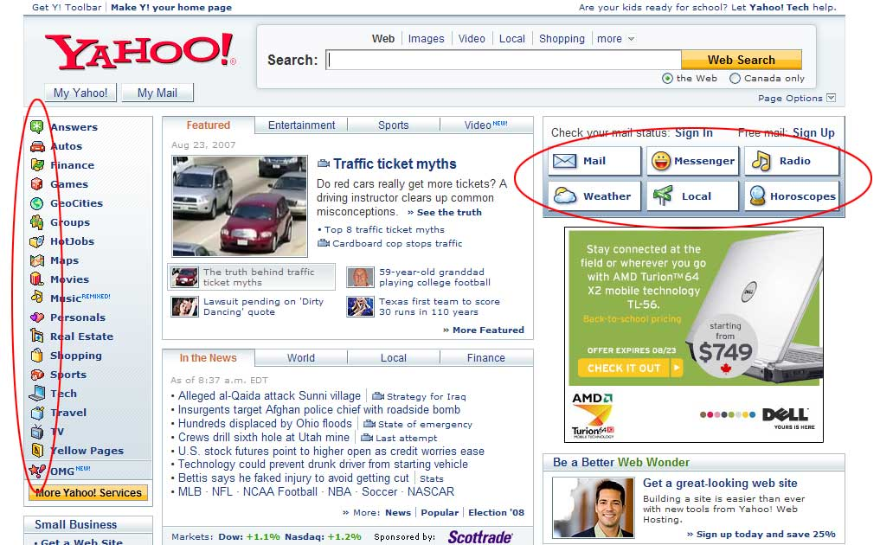
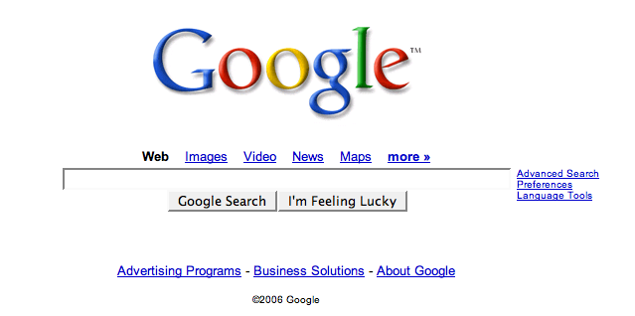
How Search Engines Work
A Search Engine is a tool that enables users to locate information on the World Wide Web.
Search engines use keywords entered by users to find Web sites which contain the information sought.

Slide 3
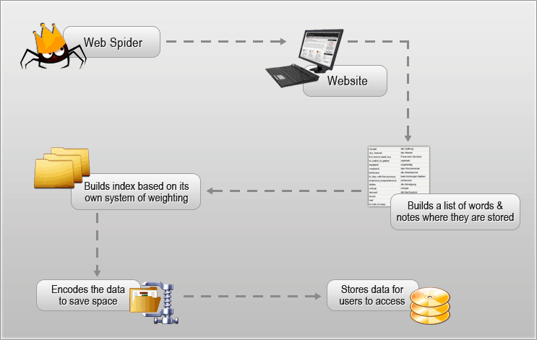
How Search Engines Work
Crawling
Indexing
Relevancy Ranking

Slide 4
How Search Engines Work
Crawling
Search engines deploy software (spiders) to scan through the content and links of your website.
Indexing
The spiders then transfer the content of your website to a giant database.
Relevancy Ranking
When a search is performed, search engines tap this database to determine which website delivers the most relevant information.
Search engines rank the resulting documents using an algorithm (mathematical formula) by assigning various weights and ranking factors.

Slide 5
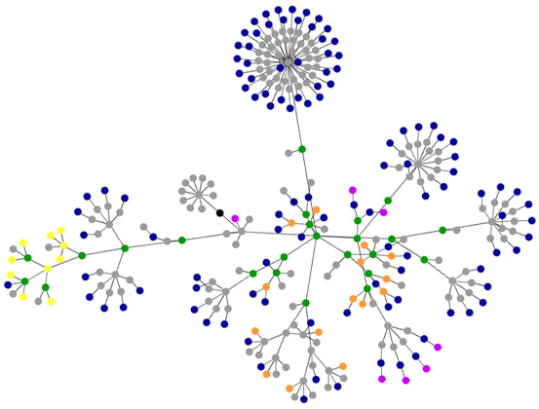
Crawling & Indexing
Without links, the engines might never find this page
Notes:
5
5

Slide 6
What is Search Engine Optimization (SEO) ?
The process of improving web pages so they rank higher in search engines for your targeted keywords.
The act of modifying a web site’s build, content, and inbound linking to increase its ranking in organic/natural (vs. paid), crawler-based listings of search engines
The active practice of optimizing a web site by improving internal and external aspects in order to increase the traffic the site receives from search engines.

Slide 7
Why SEO?
85% of all traffic on the internet is referred to by search engines.
72% of searchers stop with the top 10 search results, and 90% stop with the top 30
A natural search receives 250% more traffic than paid search.
A search performed by a search engine that displays the links on the results page in order of relevancy.
The ranking order is based on some algorithm such as Google's notable method that uses "backlinks."
Contrast with "paid ads," which appear up front on the first page because they were paid for by their advertisers.

Slide 8
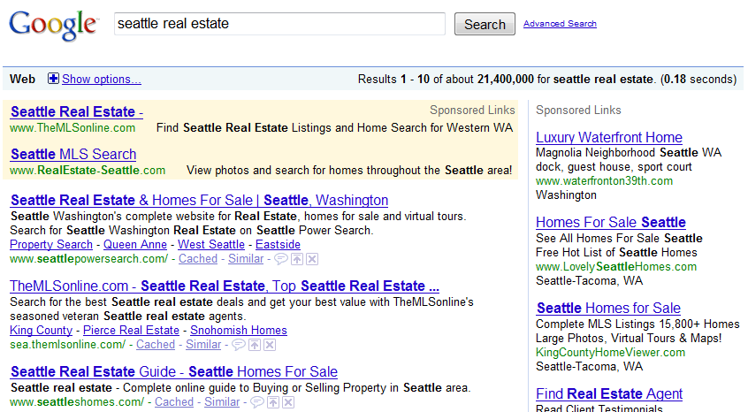
Organic vs. Paid Search
Paid
Organic
Notes:
8
8

Slide 9
Organic vs. Paid Search
10% of Clicks
90% of Clicks
Notes:
9
9

Slide 10
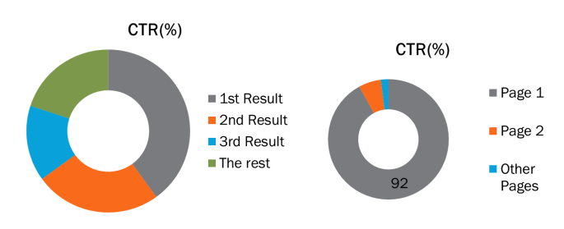
Click Through Rate

Slide 11
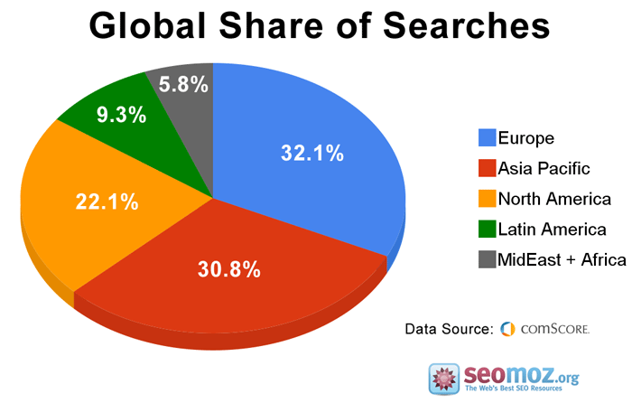
Notes:
11
11

Slide 12
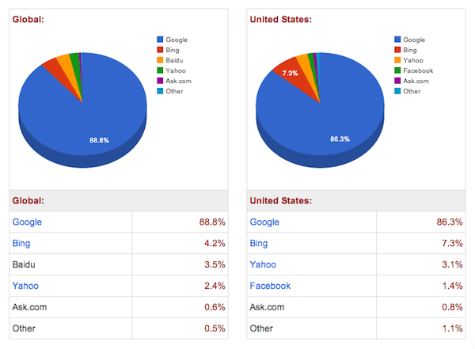
Search Engine Market Share
Notes:
12
12

Slide 13


SEO
Pros Higher return on investment Long-term Pay less Organic Results are more clickable | Cons 2-3 months before visible results Some of the websites are not search engine friendly Can’t guarantee exact results
Notes:
Pros
It has better return on investment than any other spending on marketing campaign. The effect is long term.
You spend less than you would spend other marketing activities.
Most of the people click on organic results but not paid advertisements.
The higher you are in search results, the more people trust you.
Cons
It takes 2-3 months until you see results.
Some of the websites are not search engine friendly. E.g. if you just want a several page website to tell about yourself, your services and address, it might not be easy to promote.
Can’t guarantee exact results.

Slide 14

SEO: Website Optimization Elements
Search engine spiders do not see the website like the common visitor.
Therefore, keep it optimized and systemized.
You can check how a search engine sees your website by using the following free tool: www.seo-browser.com
Notes:
Always keep in mind that the search engine spiders do not see the website like the common visitor. They don’t think it’s “cute” and bookmark it.
That is why it is always important to keep it optimized and systemized.

Slide 15
SEO: Website Optimization Process
On page optimization is the modifications done on the page/HTML coding.
Off-page optimization refers to factors that are off-site or depends not on the coding on your page but have an effect on your Web site or Web page listing in natural search results .

Slide 16
On-Page Optimization
Make your Website look Clean & Simple
Observe your competitor
Crawlability / Link Architecture
Research on Keywords
Keyword Domain Names
Structure File name
Search Engine Friendly Sitemap
Write Good Content
Write an Attractive Title
Meta Description Tag
Meta Keyword Tag
Have Robot tags
Alt Tags for images
Headings
Improve Keyword Prominence, Density & Proximity
Keyword Rich Anchor Text

Slide 17
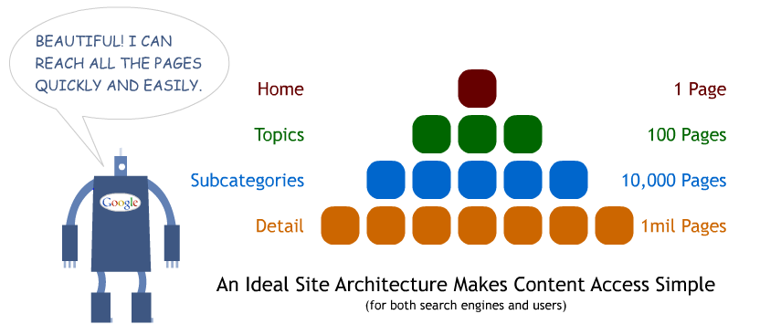
Crawlability / Link Architecture
Notes:
17
17

Slide 18
Do your keyword research
Keywords are the search terms your visitor enters into the search box in Google, Yahoo etc. when trying to find your site.
Research keywords and keyphrases before you create your site.
Don't target a keyphrase just because it sounds right to you, or because it gets a lot of searches.
Target keyphrases rather than single keywords.
Stay away from 1-word (or possibly even 2-word) keyphrases that have thousands of competitive sites in search results. Instead, use tools such as Wordtracker and the AdWords Keyword Suggestion tool to find relevant niche keyphrases with high search volume and low competition.
For example, if your online store sells Mega Widgets in the Boston area, target the keyphrase "mega widgets boston", rather than just "widgets".
Use longer words and plurals.
If you have keywords that are very competitive, consider narrowing your focus to improve results.

Slide 19
Do your keyword research
Avoid generalisation.
Also make sure your keywords have a reasonable density (i.e. they appear fairly often in the text blocks — but not too often) and prominence (place them near the start of each text block).
Make sure you use text rather than images in the page where possible. This is particularly true of navigation menus. If you must use an image, make sure it has keyword-rich alt text.
Do not use common words eg ‘the’ ‘and’ ‘of’: spiders ignore them.

Slide 20
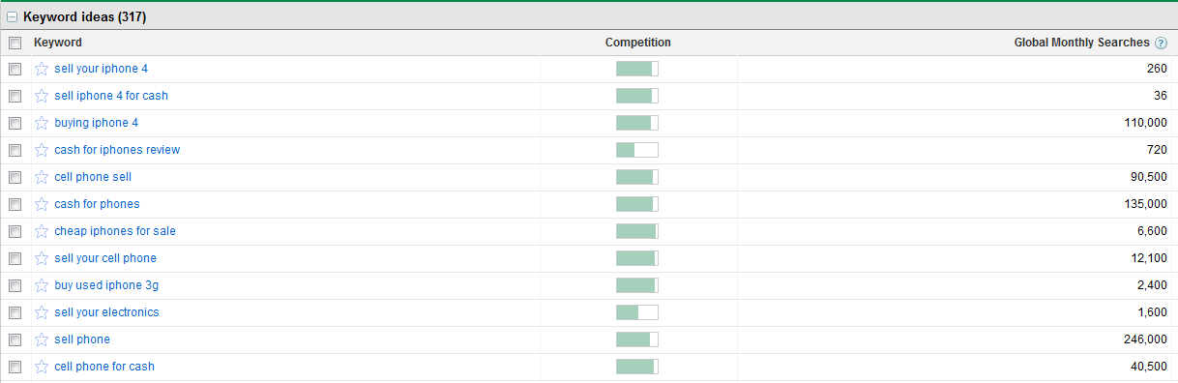
Do your keyword research
Search relevant keywords using Google Keyword Planner Tool

Slide 21
Do your keyword research
Brainstorm
Survey Customers
Applying data from keyword research tools and analytics programs to further refine your selection
Use tools such as Google Analytics to see which keyphrases result in the most goal conversions, traffic.

Slide 22
Do your keyword research
Once you have a good list of keyphrases, deploy them sensibly throughout your site pages. Make sure you've used your keywords in the following text blocks :
The title tag
The h1 and h2 headings in the page
Link text (in links within the page, and in links from other pages)
The page URL
Image alt text
Bold and italicised text

Slide 23
Keyword Domain Names
What is a Domain? www.website.com
Keyword Domain Names - These are domain names that contains a keyword in it.
www.detergentbar.com
Choose a domain name that will increase your search engine ranking.
Register for >5 years – registered longer is more serious business.
Use keywords, location, advertising terms, product names.

Slide 24
Search Friendly URLs
www.nationalgeographic.com/animals/african-elephants
Keywords in page name,
separated by hyphen
Single domain
Shallow folder structure with relevant words
Notes:
24
24

Slide 25
Search UN-Friendly URLs
Xyz3.nationalgeographic.com/a/?q=31z&mg=vv7z&sd=8
No keywords in the URL string
Dynamic URLs don’t perform as well as static
Notes:
25
25

Slide 26
Webpage File Naming
The filename should be relevant to your target keyword.
Don’t use spaces to separate words.
Use either hyphens or underscores, but its more advisable to use the former.
detergent-bar.html
speed-detergent-bar.html

Slide 27
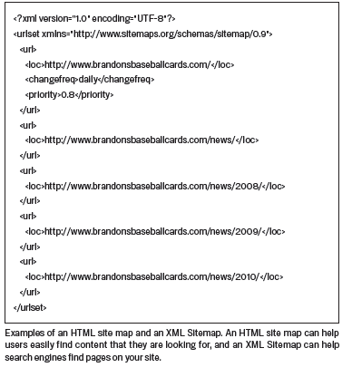
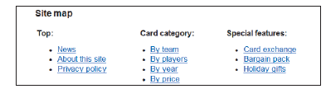
Sitemaps
Sitemaps are an easy way for webmasters to inform search engines about pages on their sites that are available for crawling.
2 types:
XML Sitemap ( For Search Engine Spiders)
An XML Sitemap is an XML file that lists the URLs for a site
Makes it easier for users to navigate
Helps search engine crawlers to access all pages and links
HTML Sitemap (For human readers)

Slide 28
Write good content
This is maybe the most important strategy of all. If your pages contain good, relevant, useful content, search engines will be more likely to rank your page higher for relevant searches.
As an added benefit, good content will encourage more sites to link to your pages, thereby further increasing your search engine ranking.
It's also good to update your content regularly. Visitors like fresh content, so they will visit your site more often. More visits lead to more links to your content, which ultimately results in more traffic.
Avoid Text in Images/Flash.
Watch out for duplicate content.

Slide 29
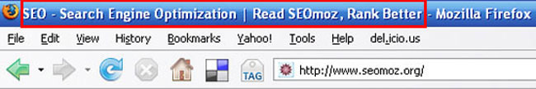
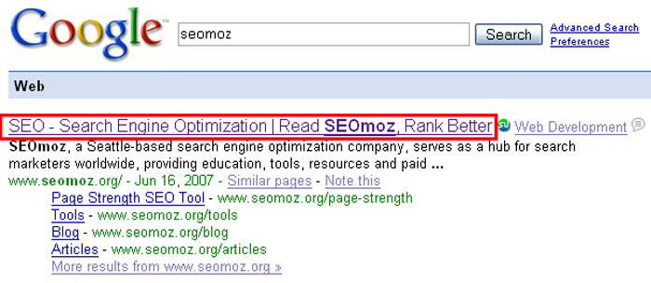
Title Tags
Notes:
29
29

Slide 30
Meta Tags - description and keywords
Metatags are HTML elements used to provide structured metadata about a Web page.
The description tag should be a useful, compelling summary of your page content.
this tag is often used to display a summary of your page in the search results, so it's worth making it keyword-rich and including a call to action.

Slide 31
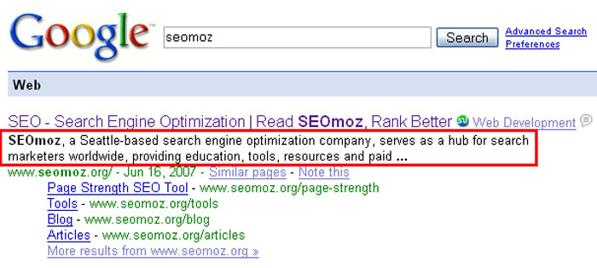
Meta Descriptions
Notes:
31
31

Slide 32
Meta Tags - description and keywords
Most search engines ignore the keywords tag these days; however it doesn't hurt to create one (if nothing else it's another chance to insert your keywords in the page). Some directories also use the keywords tag to classify sites.
Ensure that each page has unique description and keywords tags.
If a search engine finds many pages with the same description and keywords, it can see those pages as less important.

Slide 33
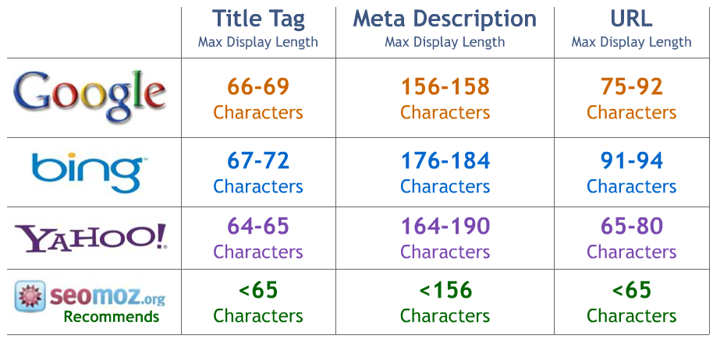
Tag Length Recommendations
Notes:
33
33

Slide 34

robots.txt File
Web site owners use the /robots.txt file to give instructions about their site to web robots; this is called The Robots Exclusion Protocol.
It works likes this:
a robot wants to visit a Web site URL, say http://www.example.com/welcome.html.
Before it does so, it firsts checks for http://www.example.com/robots.txt, and finds:
The "User-agent: *" means this section applies to all robots.
The "Disallow: /" tells the robot that it should not visit any pages on the site.
http://www.robotstxt.org/robotstxt.html
<meta name="robots" content="noindex, nofollow">

Slide 35
Images
Guidelines in Using Images:
Image filename must be relevant tide-detergent-bar.jpg
Alt Attribute alt=“Tide Detergent Bar”
Title Attribute title=“Tide Detergent Bar”

Slide 36

Headline/Header Tags
The <h1> to <h6> tags are used to define HTML headings.
For SEO – header tags indicates the level of importance in a webpage.
<h1> being the highest and <h6> being the lowest

Slide 37
Improve Keyword Prominence, Density & Proximity
Keyword density is the percentage of times a keyword or phrase appears on a web page compared to the total number of words on the page.
Keyword Prominence
Keyword prominence refers to how prominent keywords are within a web page
The general recommendation is to place important keywords at, or near, the start of a web page, sentence, TITLE or META tag
Keyword Proximity
Keyword proximity refers to the closeness between two or more keywords. In general, the closer the keywords are, the better

Slide 38
Improve Keyword Prominence, Density & Proximity
For example:
How Keyword Density Affects Search Engine Rankings How Keyword Density Affects Rankings In Search Engine
Using the example above, if someone searched for "search engine rankings," a web page containing the first sentence is more likely to rank higher than the second.
The reason is because the keywords are placed closer together. This is assuming that everything else is equal, of course.

Slide 39
Anchor text
Keywords become the genesis of your anchor text, but don’t fall into the trap that many SEOs do.
Here’s a common problem – I want to rank for “men’s jackets” and in doing so I’ve determined that all of the links that I will attain will be targeted with “men’s jackets” as the anchor text. This is a mistake. While you certainly need some focus on the primary keywords within your anchor text it’s equally as important to work with derivatives of that keyword.
Moderation and diversification are important principles in anchor text selection. Do your homework and identify a set of valuable derivatives such as “men’s winter jackets” and “cheap men’s jackets.” Diversifying the keywords within your link profile will help it appear natural.
An anchor text usage rule of thumb that we’ve seen success with looks something like this:
50 percent containing the exact match keyword.
30 percent to 40 percent containing keyword derivatives.
10 percent to 20 percent containing brand terms/URL.

Slide 40
Off-page Optimization Processes
Off-site optimization consists of anything that promotes your website - Link Building
Submit your website to Search Engines & Directories
Create and updates profiles in Social Media sites: Facebook, Twitter etc.
Social book marking - it serves two purposes: It gets you incoming links and it popularizes your website in your community.
Submit your link with a brief description, and include your keywords in the title of the bookmark and in the tags.
Implement a quality link building campaign (next slide)
Conduct E-mail Marketing
Forums: Post your comments, thoughts and you can also provide a link to your website.

Slide 41
Off-page Optimization Processes
Blogs: Submit your blog with proper keyword tags which helps in your blog listing.
Leave a meaningful comment on a relevant blog post with your kink
Articles: Write keyword & content rich articles on your own and post in article junctions available online.
Press Releases: You can post Press Releases.

Slide 42
Link Building Strategies
Most search engines rank sites more highly if they're linked to by other, well-respected sites.
The key here is "well-respected". Just getting linked to from hundreds of reciprocal link pages is not going to do much for your ranking. Target a few relevant, good-quality sites and directories that are full of useful info and rank well on the search engines, and try to get a link back from them.
Getting links from other high-quality sites can be a challenge. Here are some tips:
A "link to this page" function on each page of your site makes it easy for other webmasters and bloggers to link.
Get in touch with the site owner and strike up a friendship. You're much more likely to get a link back from someone who knows you.

Slide 43
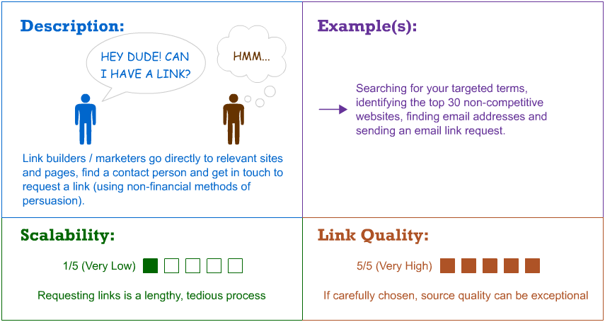
Link Building Strategies
#1 Manual Link Submissions/Requests
Notes:
43
43

Slide 44
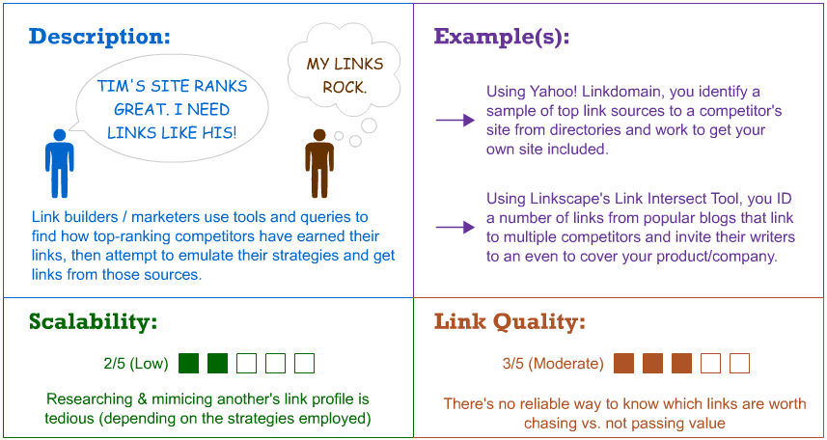
#2 - Competitive Link Research/Acquisition
Notes:
44
44

Slide 45
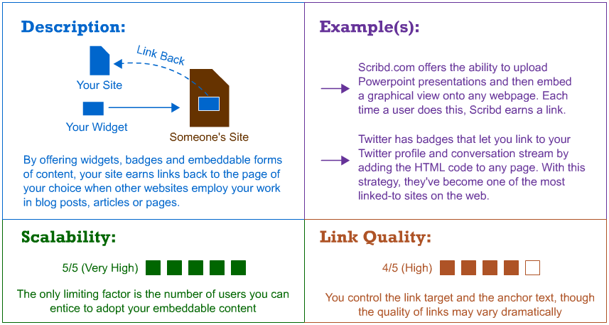
#3 - Links via Embedded Content
Notes:
45
45

Slide 46
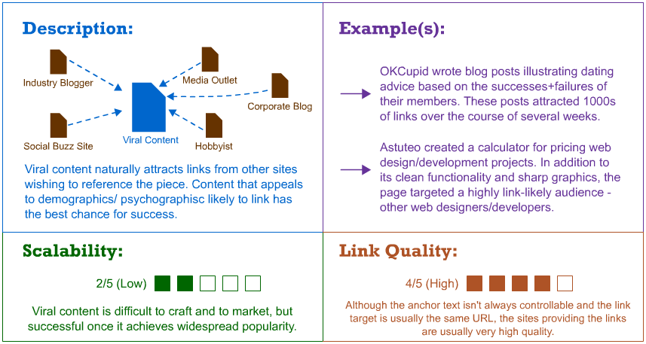
#4 - Linkbait & Viral Campaigns
Notes:
46
46

Slide 47
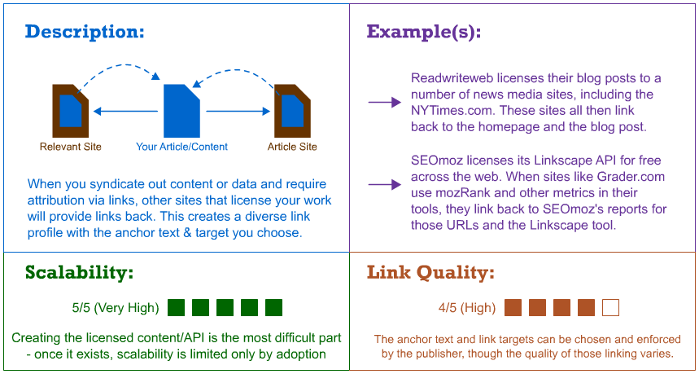
#5 - Content, Technology & API Licensing
Notes:
47
47

Slide 48
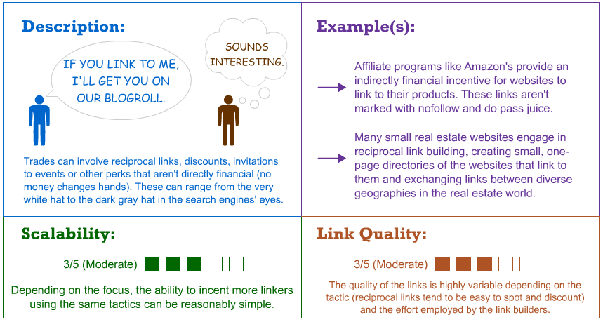
#6 - Partnerships, Exchanges & Trades
Notes:
48
48

Slide 49
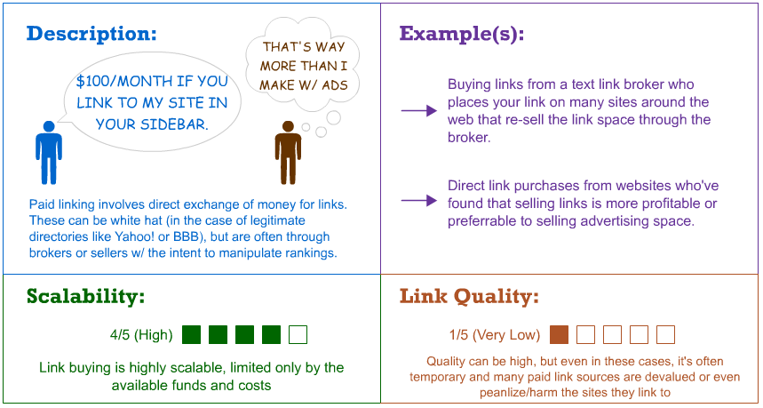
#7 - Paid Links
Notes:
49
49

Slide 50
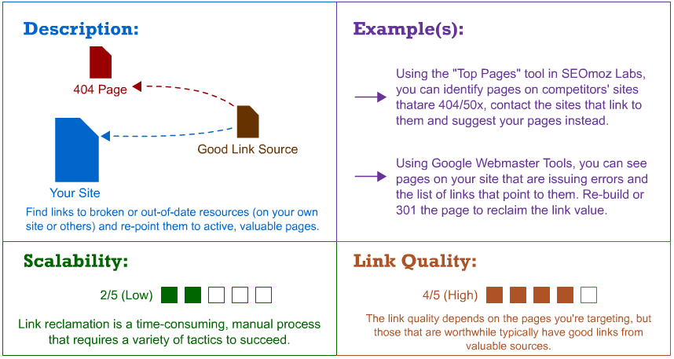
#8 - Link Reclamation
Notes:
50
50

Slide 51
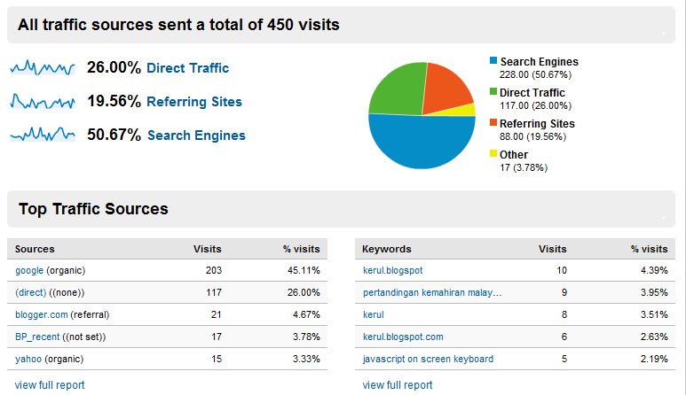
Use Google Analytics

Slide 52
Keep abreast of the latest SEO news
Search engine algorithms change constantly, and it pays to keep up to date with the latest changes and SEO strategies. The following SEO sites are well worth bookmarking or subscribing to:
Search Engine Watch is a huge SEO resource, including articles and white papers on SEO and SEM (search engine marketing), as well as some busy SEO forums.
Matt Cutts' blog — Matt is a Google engineer, and in his blog he frequently discusses the latest changes at Google that can affect SEO.
Sphinn is a social bookmarking site for SEO topics. Great for finding out what's new and hot in the world of SEO.
SEO Book features a comprehensive, paid SEO training program, a regularly-updated blog, and some handy free SEO tools such as keyword suggesters and rank checkers.
SEO Chat contains a large number of SEO articles, a huge range of free online SEO tools, and a big forum community.

Slide 53
Avoid black hat techniques
SEO techniques come in 2 forms:
White hat techniques play by the rules of the search engines, and aim to create high-quality, relevant content.
Black hat techniques attempt to "game" the search engines by using techniques such as keyword stuffing (overusing keywords in a page), hidden text, and cloaking (presenting different versions of a page to real visitors and search engines).
Black hat SEO techniques can sometimes produce a short-term hike in traffic; however such sites invariably get weeded out — or, worse, banned altogether — by the search engines.
Black hat SEO simply isn't worth the risk if you want to build a long-term stream of traffic from search engines.

Slide 54
Things we need to avoid
Duplicate Contents
Keyword Stuffing
Keyword dilution
Single pixel links or hidden links
Use of Frames
Invisible Text
Link to a bad neighborhood
Text Graphics
JavaScript links
http://www.seonightmares.com/badseopractice.htm

Slide 55

Social Media Optimization
Social media optimization (SMO) is the process by which you make your content easily shareable across the social web.
Because so many options exist for where people can view your content, the content model for the web has shifted from, "We have to drive as much traffic to our website as possible," to the more pragmatic, "We have to ensure as many people see our content as possible."
You'll still want most people to see your content on your site — and if you're doing it right they will — but helping people view content through widgets, apps and other social media entry points will accrue positive benefits for your brand. The more transportable you can make your content, the better.

Slide 56
Social Media Optimization
Social networks are driving an increasing amount of traffic to an increasing number of websites. Sites like Comedy Central, Forever 21 are seeing more traffic from social networks than they see from Google.
How social referral traffic is performing for you most likely depends on two factors:
How interesting your content is; and
How easily shareable you have made that content across a variety of networks.

Slide 57
Tracking Results: Web Analytics
As defined by Web Analytics Association:
Web analytics is the measurement, collection, analysis and reporting of internet data for purposes of understanding and optimizing web usage.
Web analytics provides data on the number of visitors, page views etc to gauge the popularity of the sites which will help to do the market research.
Tools
www.google.com/analytics
www.alexa.com
http://web.analytics.yahoo.com/

Slide 58
Tracking Results: Web Analytics
Track Your SEO Results via Google Analytics
It is a free service offered by Google that is able to generate detailed statistics about your website.
Track visits, pageviews, bounce rate and time
Research visitors profiles
Identify the best keywords and optimize
Identify the best traffic sources
Compare to other similar websites
Create custom reports
Notes:
Track visits, pageviews, bounce rate and time
Research visitors profiles
Identify the best keywords and optimize based on them
Identify and capitalize on the best traffic sources:
-referring sites
-direct traffic
-organic search
-PPC campaigns
Set conversion goals
Track AdWords and AdSense
Compare to other similar websites
Create custom reports

Slide 59
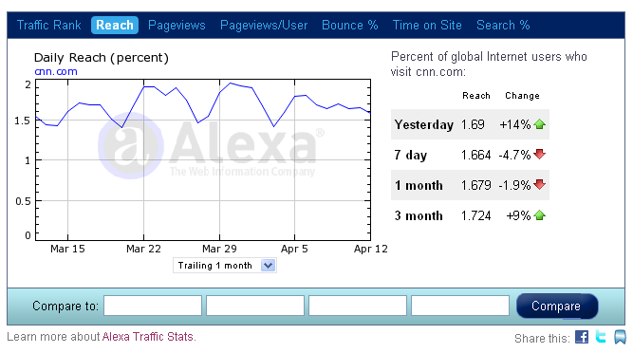
Tracking Results: Web Analytics
Check your website analytics with Alexa.com
Ranking
Backlink amount
Fast and connected to Facebook

Slide 60
Tracking Results: Web Analytics
SEO Book and SEO Chat — these 2 sites offer a large range of free, Web-based SEO tools, many of which give you useful information about how your site is faring in the search results.
Benefits of web analytics
Monitor visits
Help to optimize your website
Create cost effective marketing plan

Slide 61


PP What? PPC!
Pay Per Click (PPC) is an Internet advertising model used on websites, in which advertisers pay their host only when their ad is clicked.
With search engines, advertisers typically bid on keyword phrases relevant to their target market.
Content sites commonly charge a fixed price per click rather than use a bidding system.

Slide 62

Popular Pay per Click Programs
Appear as “sponsored listings”
Bid on price per click
Typically have very good tracking tools and statistics
Ability to control ad text
Can set budgets and spending limits
Google AdWords and Overture are the two leaders

Slide 63
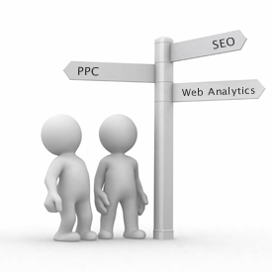
PPC vs. SEO
Pay-Per-Click | “Organic” SEO
results in 1-2 days easier to use ability to turn on and off at any moment generally more costly per visitor easy to compete in highly competitive market space ability to target “local” markets better for short-term and high-margin campaigns | results take 2 weeks to 4 months requires ongoing learning and experience to reap results very difficult to control flow of traffic generally more cost-effective, doesn’t penalize for more traffic SERPs are more popular than sponsored ads very difficult to compete in highly competitive market space can generate exposure on related websites and directories more difficult to target local markets better for long-term and lower margin campaigns

Slide 64
URL Submission
Google - http://www.google.com/addurl/
Yahoo! - http://siteexplorer.search.yahoo.com/submit
Bing - http://www.bing.com/docs/submit.aspx

Slide 65
Ranking High in Search Results
Ranking by Google
Google ranks a website based on
Relevance
Importance
PageRank
Google Panda
Check: http://www.prchecker.info/
Page Rank checker is a free service to check Google™ page rank instantly via online PR checker or by adding a PageRank checking button to your web pages
Notes:
-Relevance: Matching search term to the website content, taking into consideration the geography and web search history, as well as incoming links
-PageRank: The ranking of websites by Google. It gets a value from 1 to 10. The higher the rank, the better.

Slide 66
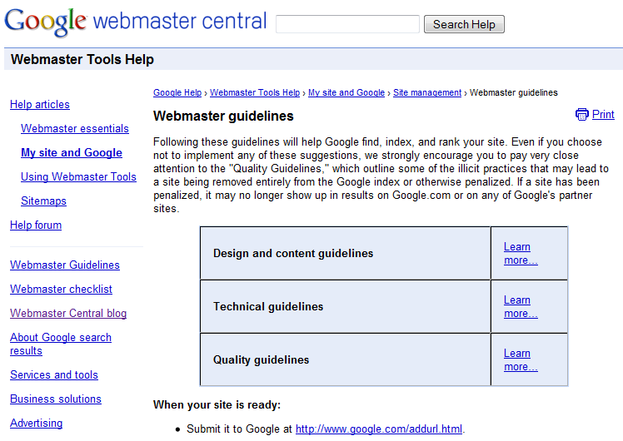
Search Engine Guidelines
www.google.com/support/webmasters/bin/answer.py?hl=en&answer=35769
Notes:
66
66

Slide 67
Check your Google Status
See indexed pages in your site (determine if your site is still in the Index)
site:www.ittralee.ie
See pages that link to your site
link:www.ittralee.ie
Results on how your site is indexed
info:www.ittraee.ie
See similar pages to your site
related:www.ittralee.ie

Slide 68
Useful sites
www.opensiteexplorer.org
Googles webmaster tools
https://developers.google.com/speed/pagespeed/insights/?hl=en&utm_source=wmx&utm_campaign=wmx_otherlinks&url=www.ittralee.ie&tab=desktop
Google Analytics
http://www.linkpopularity.com/
Googles Keyword Planner
http://tools.pingdom.com/fpt/
http://moz.com/tools

